Slide 1


Modernization of the MDAnalysis developer tools
Tyler Reddy
November 2025
Los Alamos National Laboratory
LA-UR-25-30736

Slide 2
Why we need to worry about this
Capabilities | setuptools (current approach) | meson | CMake
Multi-language build support | absorbed distutils (std library); distutils disappeared in Python 3.12 (PEP 632); NumPy then ripping out numpy.distutils | Built from scratch to handle the multi-language build system capabilities that had to be cobbled together in a complex way in the original SP ecosystem | Also a sophisticated multi-language build system, but ~1,000,000 lines of C/C++ instead of ~25,000 lines Python
(Re)build performance/capabilities | Direct compiler incantations; concurrency is limited | Uses generators (i.e., ninja); concurrency/incremental rebuilds near optimal | Uses generators (i.e., ninja); concurrency/incremental rebuilds near optimal
Analysis of builds | Build output is very messy | Formally structured build logs/tooling | Formally structured build logs/tooling
Cross Compilation | - | Supports Cross Compiling | Supports Cross Compiling
Testing multiple compilers simultaneously | - | Full out of tree build support | Full out of tree build support
Developer “overhead” | “Just works” for pure Python projects | Requires listing every individual file and target | “Requires” listing every individual file and target
Customizing the build | Compiler config harder to control | Compiler warnings/settings easy to control | Compiler warnings/settings easy to control
See also: https://labs.quansight.org/blog/2021/07/moving-scipy-to-meson

Slide 3


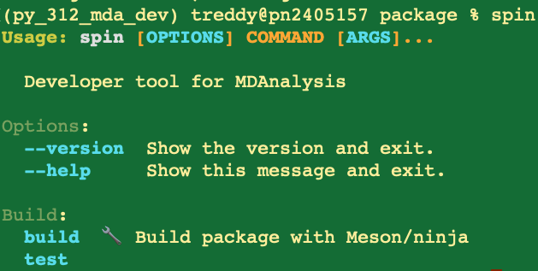
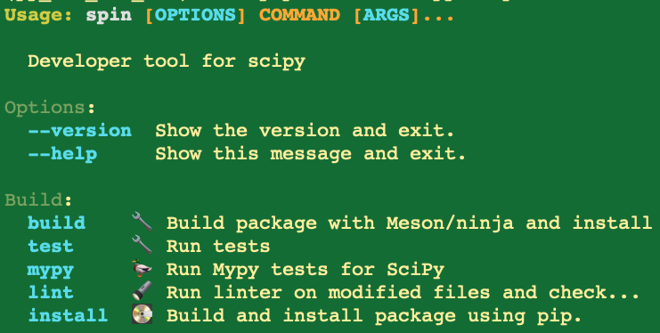
Motivation: why meson and spin?
Other scientific Python projects have made the transition; facilitate transfer of compiler/platform portability shims, improvements, fixes from those projects: NumPy, SciPy, scikit-image, scikit-learn, pandas.
Reduce friction in the transfer/mobility of developer talent between these projects and MDAnalysis.
meson is well-supported, written in Python (CMake written in C/C++), and meson-python supports PEP 517 wheel builds (a notable alternative is scikit-build, which uses CMake).
Build speed/reliable concurrency control, incremental rebuild performance.
Current status: Prototype in gh-5122 (most tests pass; 1-3 failures on Linux/Mac)

Slide 4
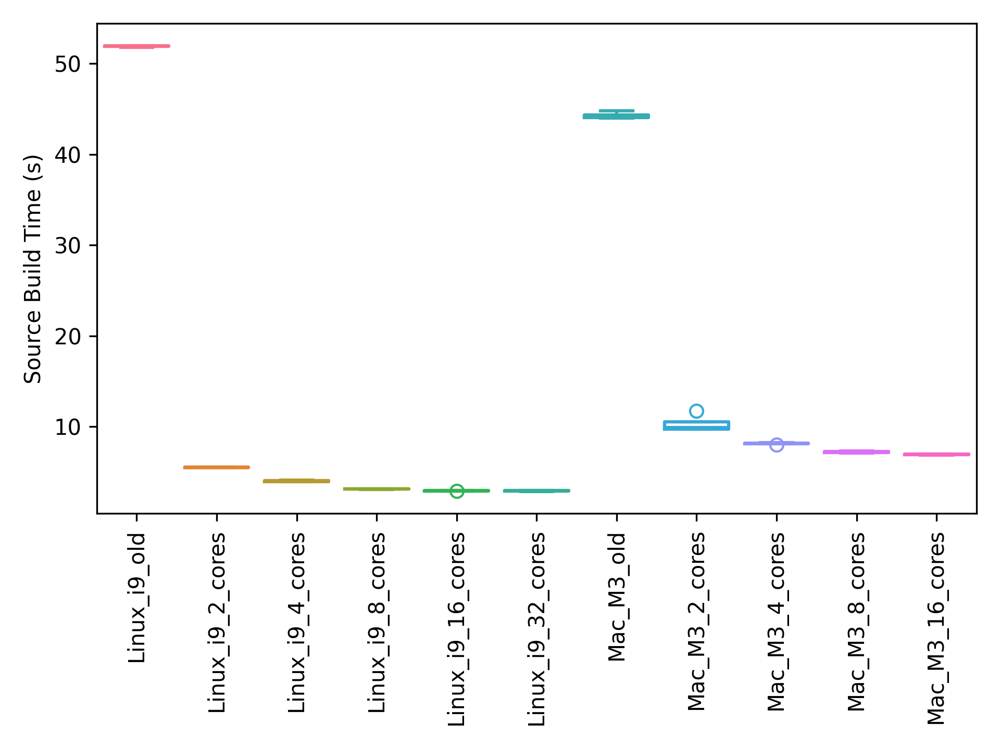
Build system timing: new vs. old
Data = 4 repeats
Timings collected on feature branch treddy_meson_expt at hash 015241bf.
New incantation sample: spin build –j 16 Old incantation sample: python -m pip install -v . --no-build-isolation --no-deps
Hardware and compilers: Linux i9-13900K; GNU 11.4.0
Mac M3; Apple clang version 17.0.0
Caution: Differences in –O level

Slide 5
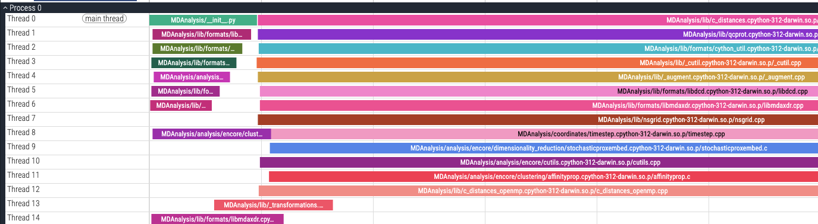
Tooling Advantages: Build Profiling
spin build -j 16
python ninjatracing.py build/.ninja_log > trace.json load into chrome://tracing/ or https://ui.perfetto.dev/ caution: latest ninja not supported yet (though it works just fine):
https://github.com/nico/ninjatracing/pull/39
Produced on feature branch treddy_meson_expt, hash 015241bf4, on M3 Mac using Apple clang version 17.0.0.

Slide 6
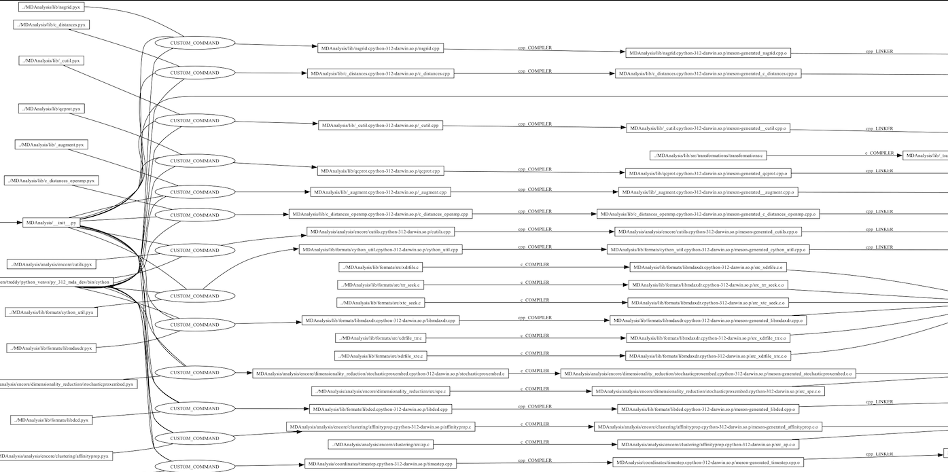
Tooling Advantages: Build Graphs
- libmdaxdr links together 6 translation units
- overall, though, we seem to have a lot of single translation unit libraries
- if we needed faster (re)builds, we could split to smaller translation units, especially as machines continue to get more cores
spin build -j 16
cd build && ninja -t graph > deps.dot
dot -Tpng deps.dot > deps.png Produced on feature branch treddy_meson_expt, hash 015241bf4, on M3 Mac using Apple clang version 17.0.0; ninja version 1.13.0.

Slide 7
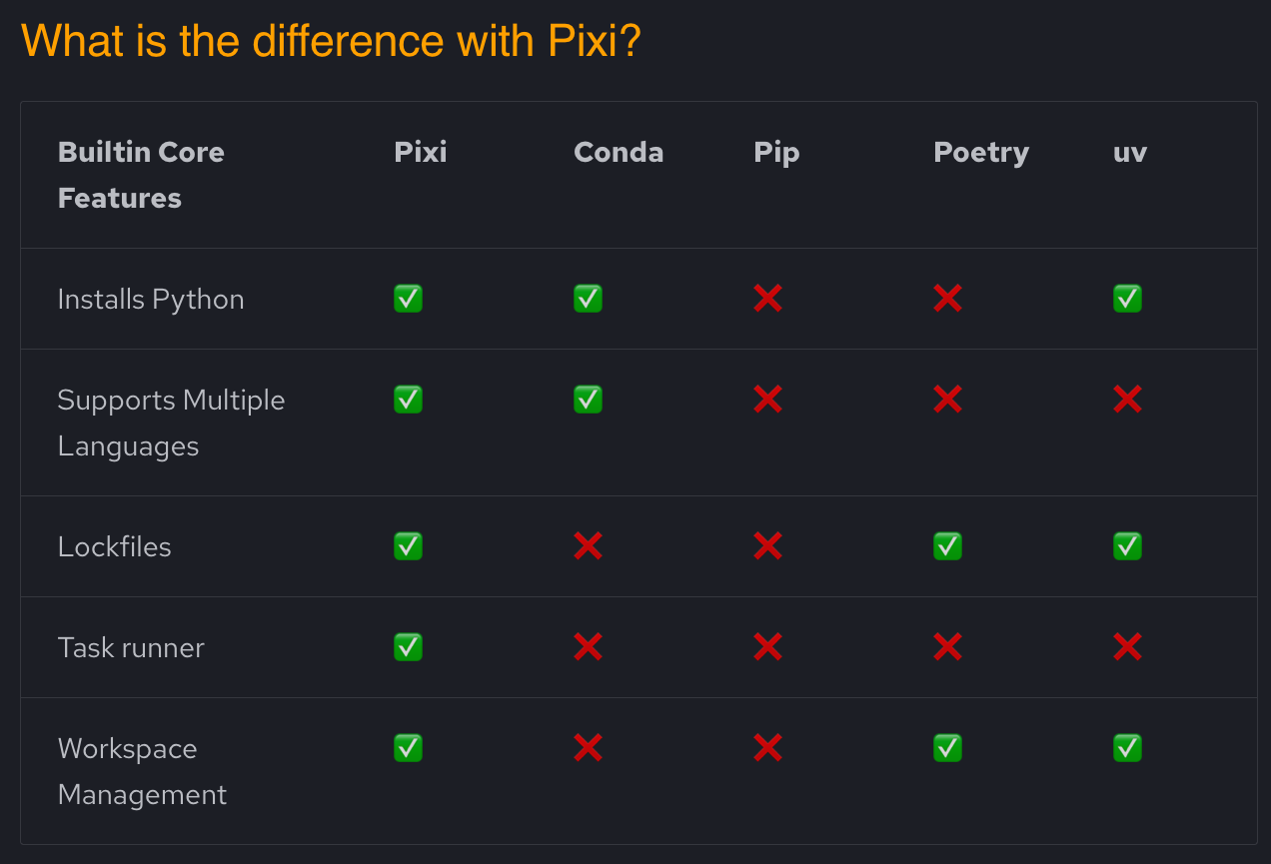
What if we want “Cargo in Python?”: Pixi vs. “others”
From: https://pixi.sh/latest/#quick-demo

Slide 8
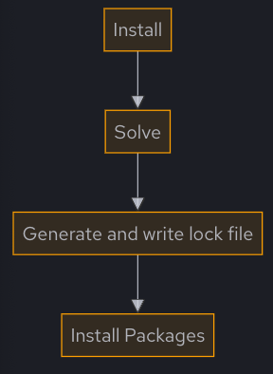
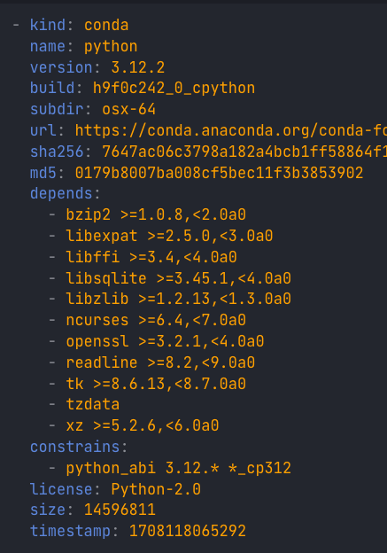
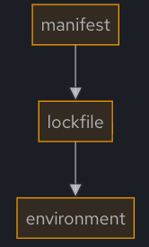

(pixi) lock files: “works on my computer” -> consistent deps
Purpose: save a working installation state, without copying entire env (easy/consistent collaboration, lighter than containers, can match CI exactly, etc.)
Onboarding/Setup Advantages are Substantial
syncing
See: https://pixi.sh/v0.22.0/features/lockfile/

Slide 9
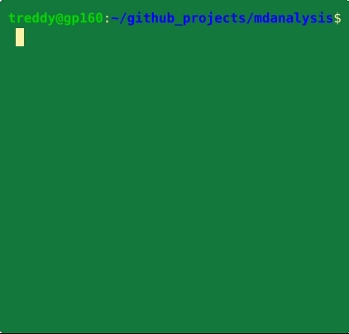

Inertial Friction Comparison – Getting Started (Matters for User Projects and Core Devs)
Fresh Checkout/Environment -> Running the testsuite
Status Quo
In the future? (gh-5122)
Recorded with: https://github.com/asciinema/asciinema

Slide 10
What’s Next?
The usual decision/debate process has not happened yet—this is just a prototype/demo/pitch.
If we were to move forward, some notable tasks beyond what is drafted in gh-5122:
Test architectures/compilers more broadly (i.e., Windows), add small number of meson/spin jobs to CI matrix to start; have a “transition period” where both build systems are in place?
Expand spin options to include: benchmarking, dropping into Python/IPython, building docs (?), linting (and other options popular in the other projects)
How to handle tests being “separate” (the current symlink shim may not be appropriate long-term)?
Fix up the small number of test failures
Improve clarity around optimization level of builds, ability to control that

